Slide 1
Fundamentals of Software Project Management (FSPM)

Slide 2
Week 6
Cost Management and Project Budget

Slide 3
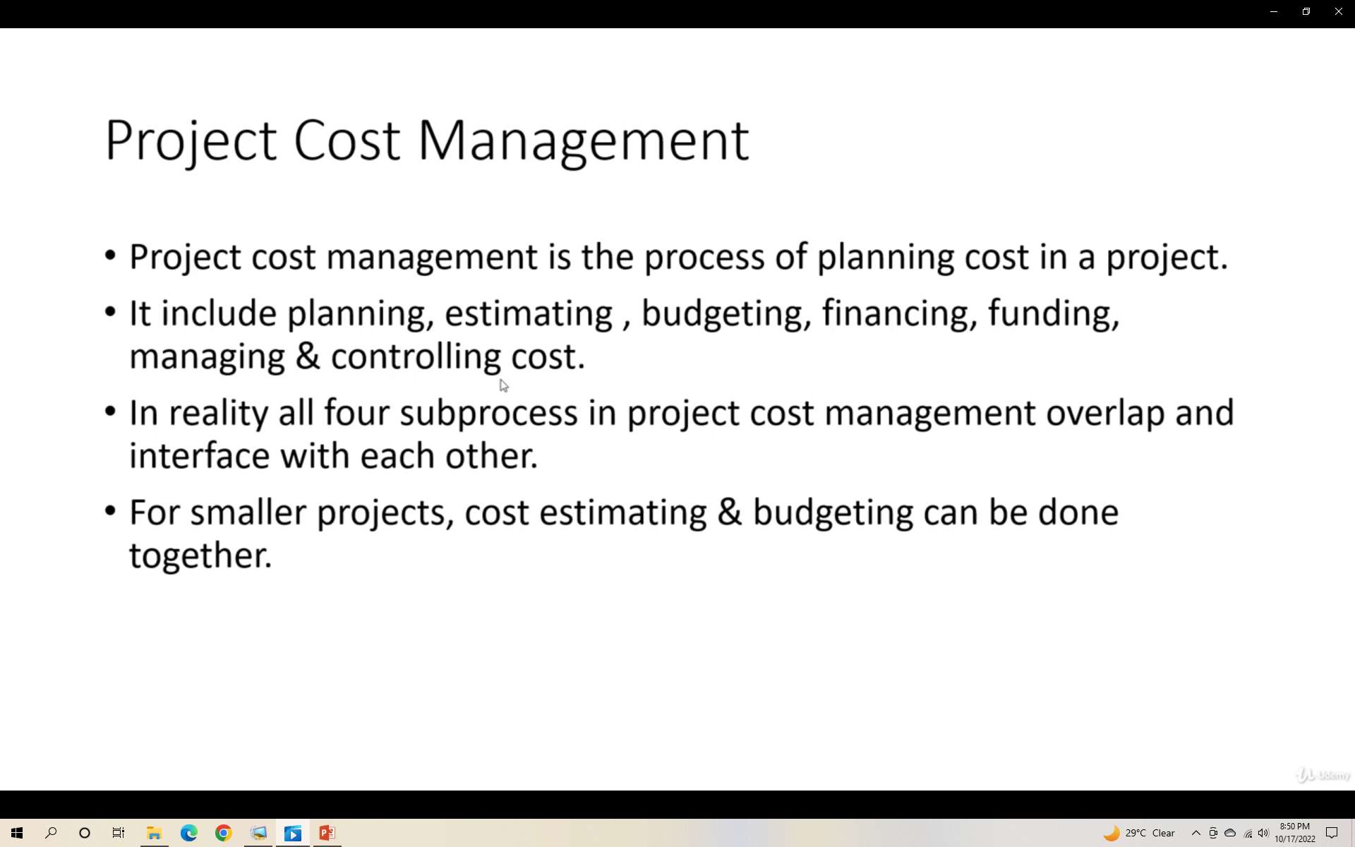

Slide 4
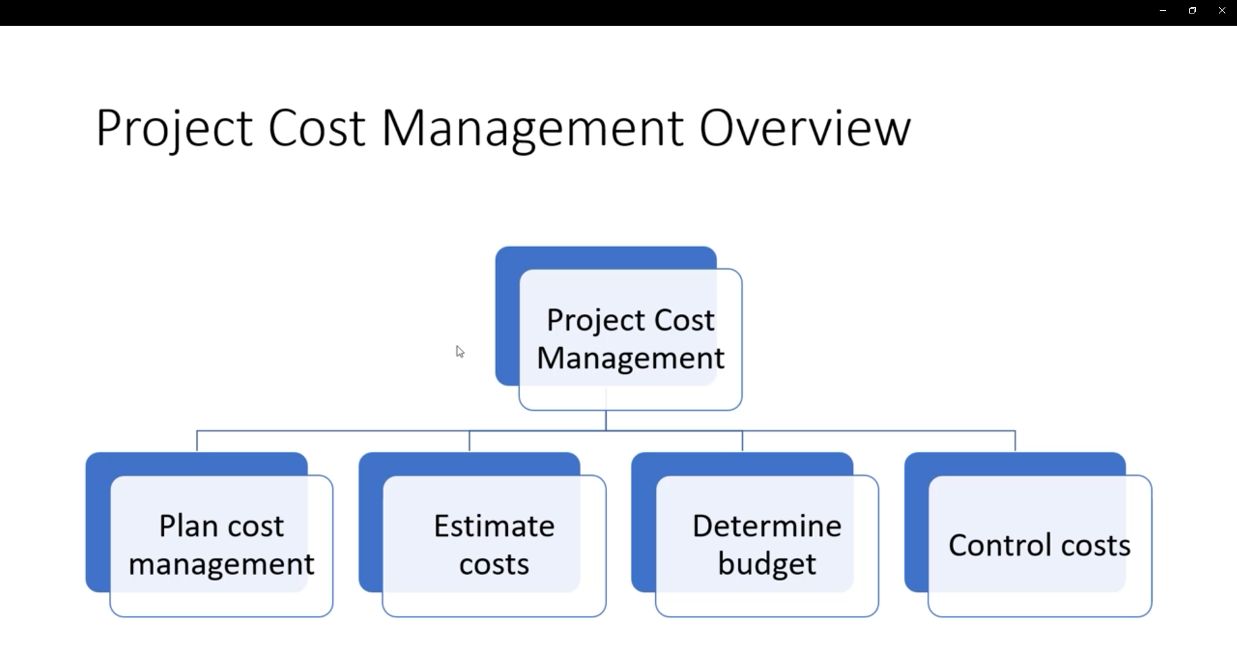

Slide 5
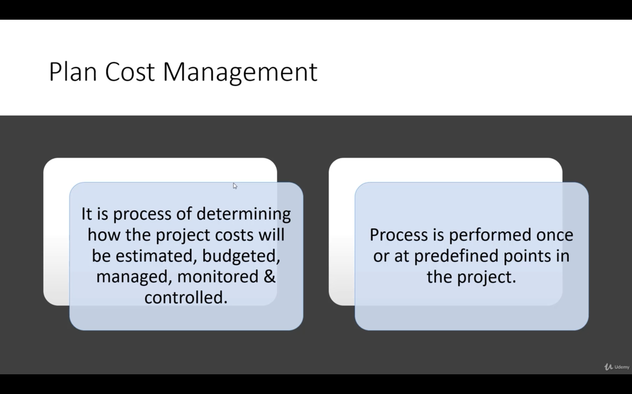

Slide 6
Form of pricing
Efforts (HR)
Per hour
Per day
Staff days
Working days(weekdays)
Fixed cost
Calculate effort and then convert into cost.

Slide 7
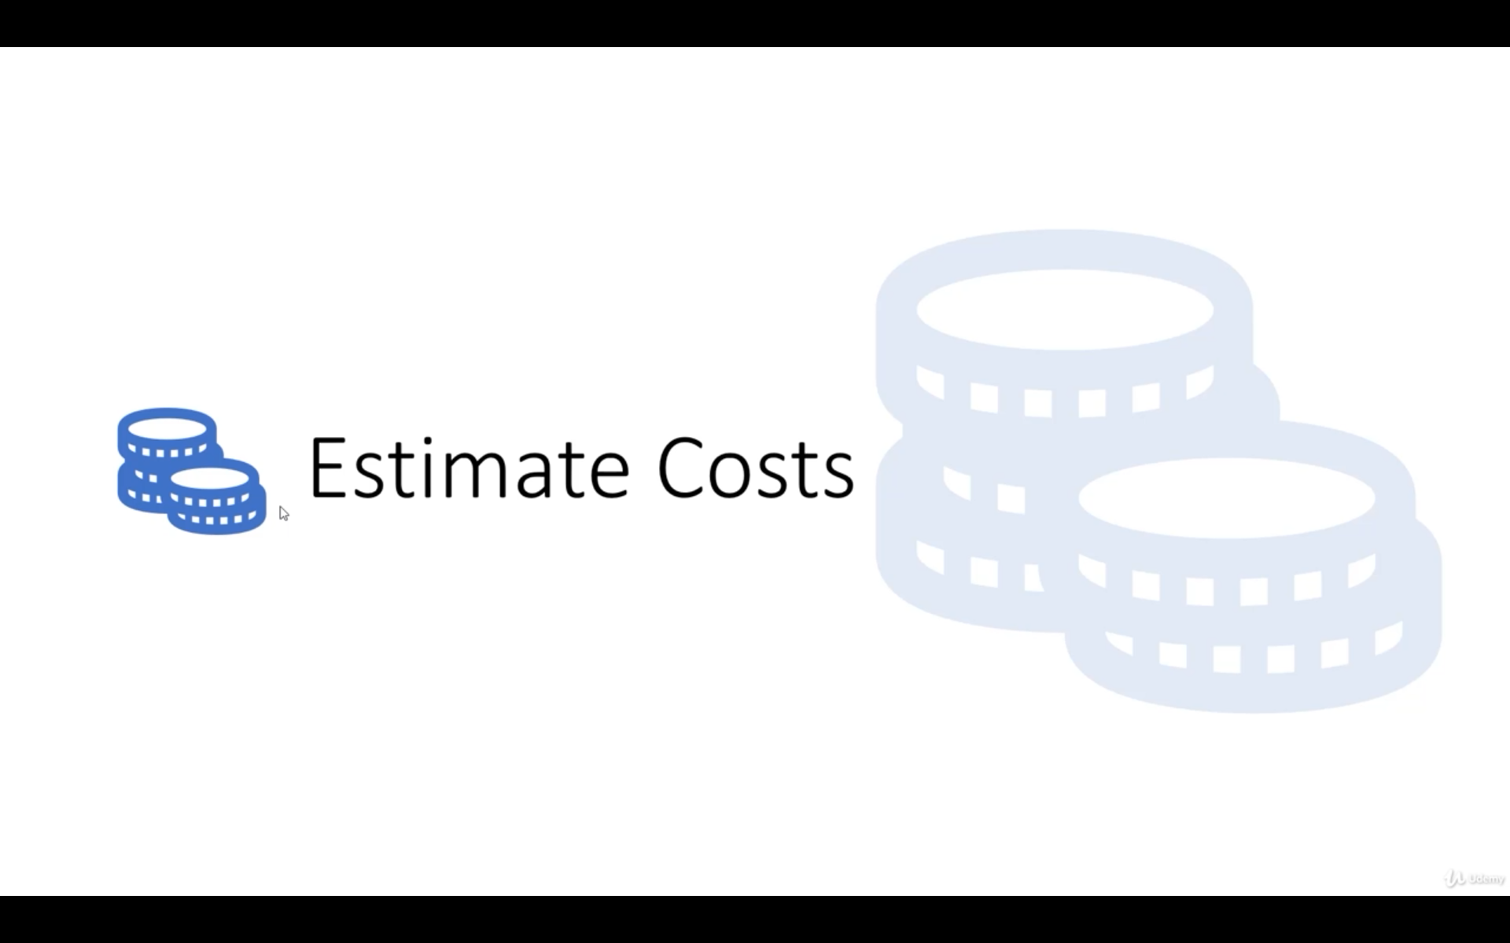

Slide 8
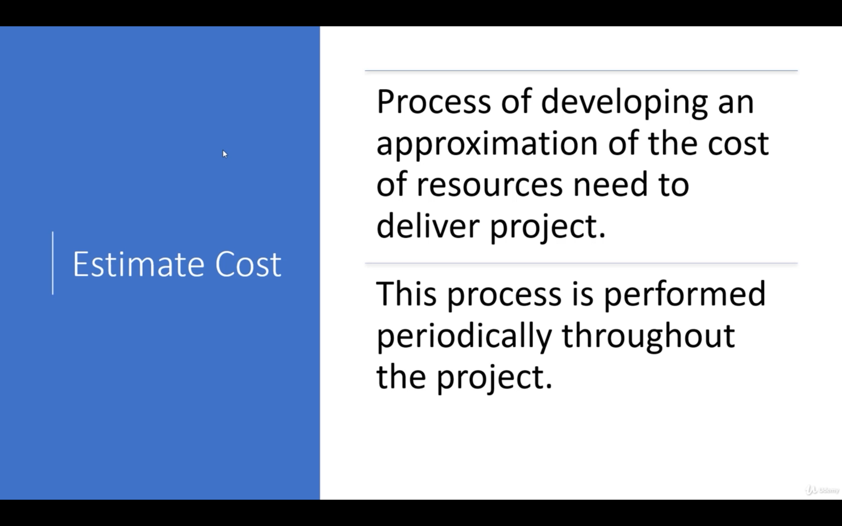

Slide 9
Tools & Techniques
Expert Judgment
Analogues estimating
Parametric estimating
Bottom-up estimating
Three-point estimating

Slide 10
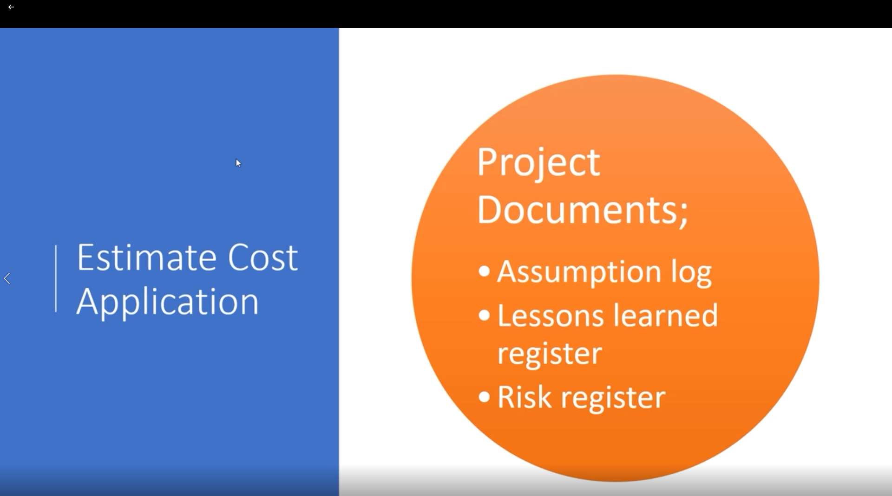

Slide 11
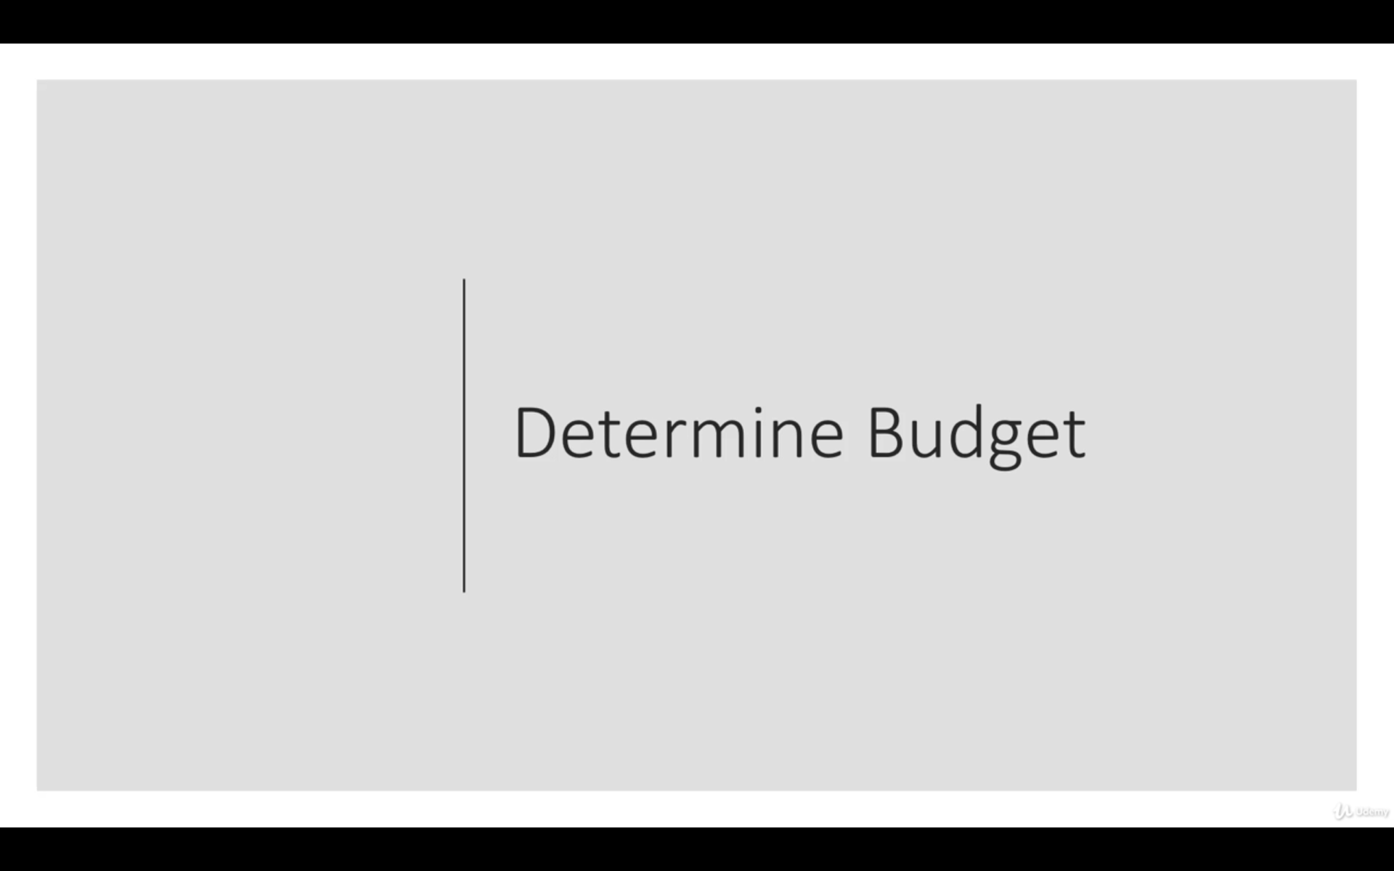

Slide 12
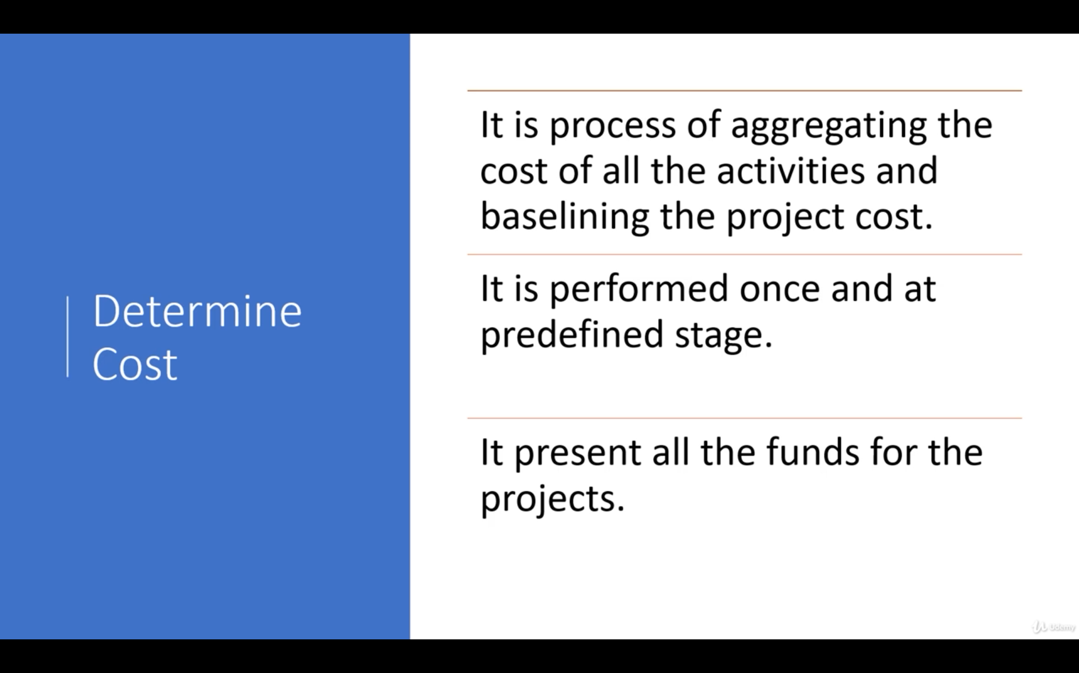

Slide 13
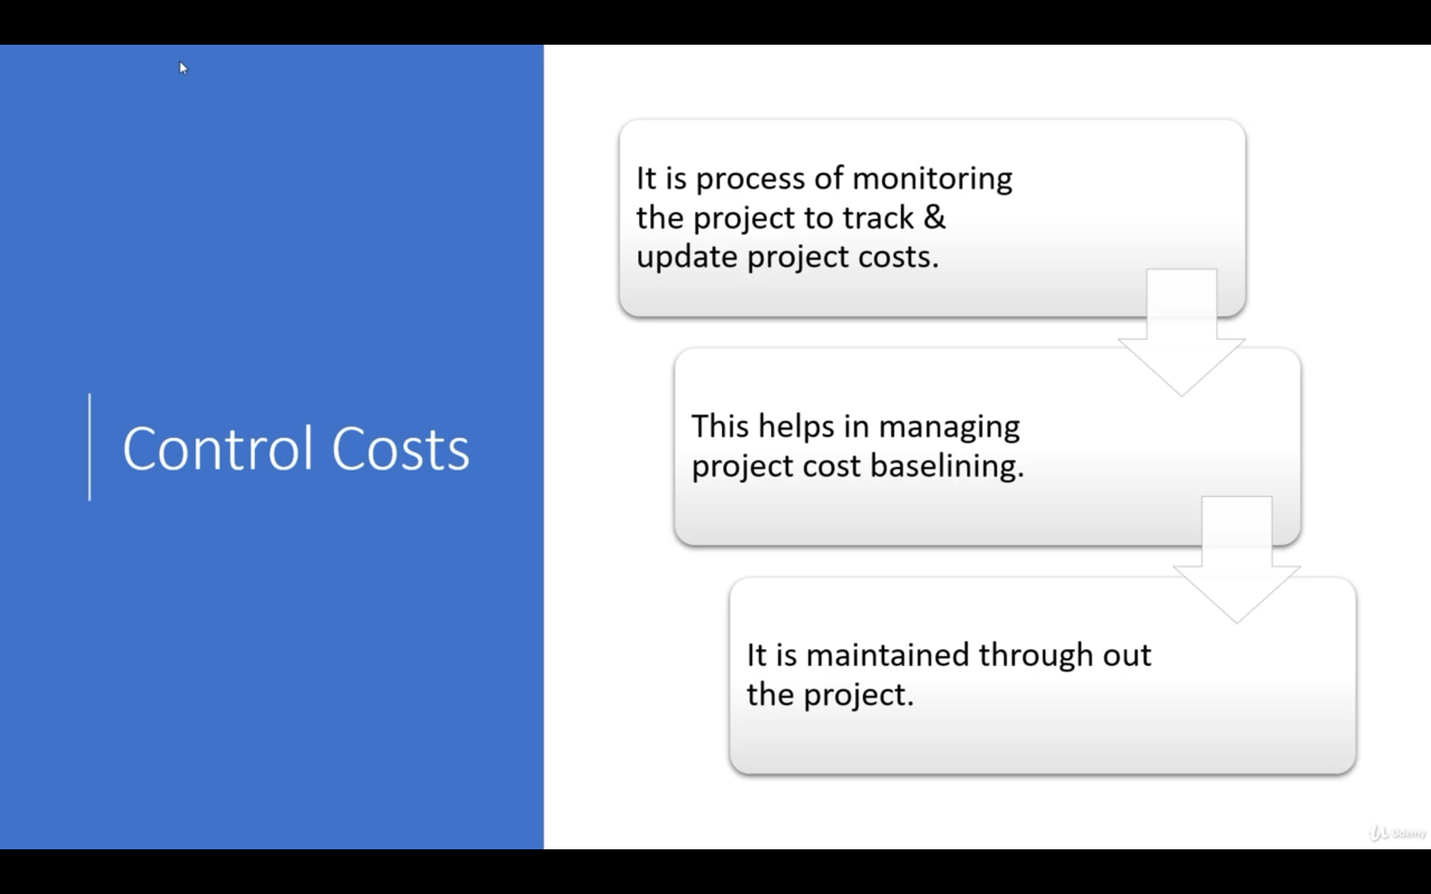

Slide 14
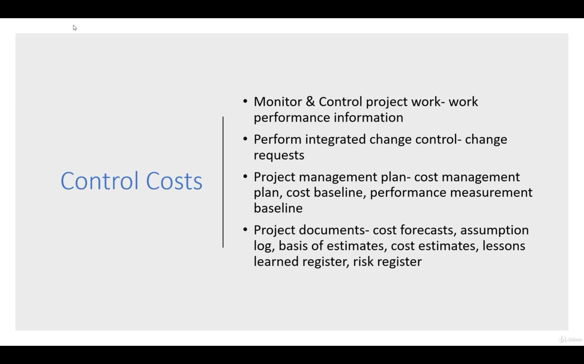

Slide 15
Analogous Estimation
The estimates are basically based on historical data by comparing the current activity with a similar activity that took place in the past.
Analogous estimation is thus a kind of expert judgment, with a dash of historical data, since no calculations are taking place.
No calculations.
Key is to identify the similarities.
Problems:
Not accurate.
Every project is unique.
No industry perspective.

Slide 16
Parametric Estimation
Based on parameters.
It is all about using a relationship between these parameters or variables (a unit cost/duration and the number of units) to develop the estimate.
Past experience
Published data
Industry data

Slide 17
Three Point Estimates
Three-point estimate is one of the best ways to come up with a collaborative estimate.
It is named such because the team members provide three values viz.
Pessimistic,
Optimistic and
Most likely estimates
For their respective deliverables.
A simple average of these 3 values is the final estimate.
Also know as Triangular Distribution

Slide 18
Three Point Estimates
Estimation can be done for the entire project,
WBS component or
It can go as granular as an activity in the WBS.

